Slide 1

Course Name: Hardware Security
Faculty Name: Prof Debdeep Mukhopadhyay
Department : Computer Science and Engineering
Topic
Lecture 10: Field Isomorphisms

Slide 2

Concepts Covered:
Recap of Groups, Rings, Fields
Binary Finite Fields
Primitive Elements
Bases
Isomorphism and Composite Fields
Construction of Isomorphisms

Slide 3
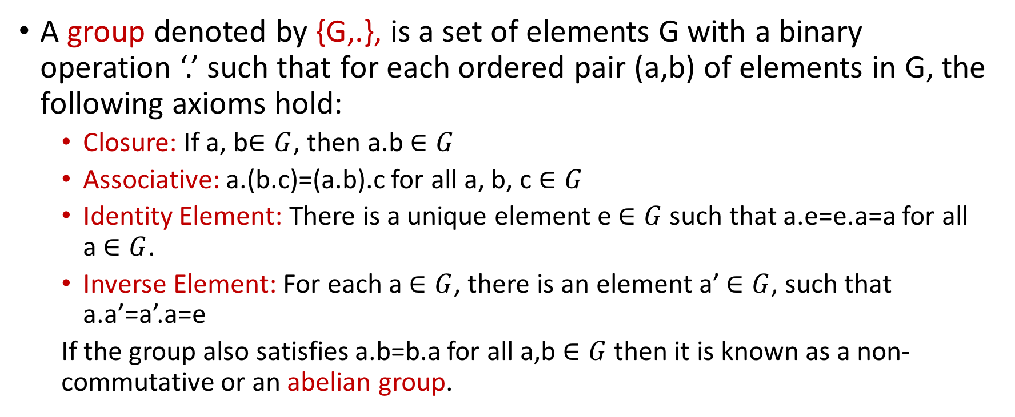
Groups, Rings, and Fields
A group denoted by {G,.}, is a set of elements G with a binary operation ‘.’ such that for each ordered pair (a,b) of elements in G, the following axioms hold:
Closure: If a, b$∈G$, then a.b $∈G$
Associative: a.(b.c)=(a.b).c for all a, b, c $∈G$
Identity Element: There is a unique element e $∈G$ such that a.e=e.a=a for all a $∈G$.
Inverse Element: For each a $∈G$, there is an element a’ $∈G$, such that a.a’=a’.a=e
If the group also satisfies a.b=b.a for all a,b $∈G$ then it is known as a non-commutative or an abelian group.

Slide 4
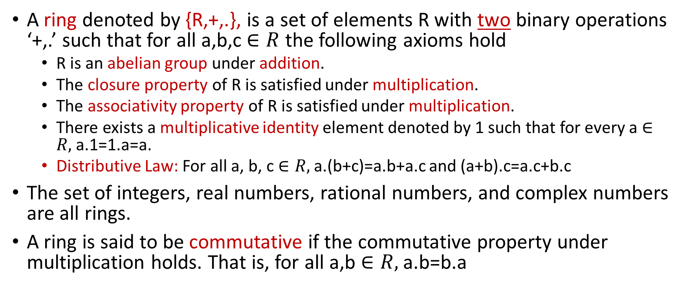
Groups, Rings, and Fields (contd.)
A ring denoted by {R,+,.}, is a set of elements R with two binary operations ‘+,.’ such that for all a,b,c$∈R$ the following axioms hold
R is an abelian group under addition.
The closure property of R is satisfied under multiplication.
The associativity property of R is satisfied under multiplication.
There exists a multiplicative identity element denoted by 1 such that for every a $∈R,$a.1=1.a=a.
Distributive Law: For all a, b, c $∈R,$ a.(b+c)=a.b+a.c and (a+b).c=a.c+b.c
The set of integers, real numbers, rational numbers, and complex numbers are all rings.
A ring is said to be commutative if the commutative property under multiplication holds. That is, for all a,b $∈R,$ a.b=b.a

Slide 5
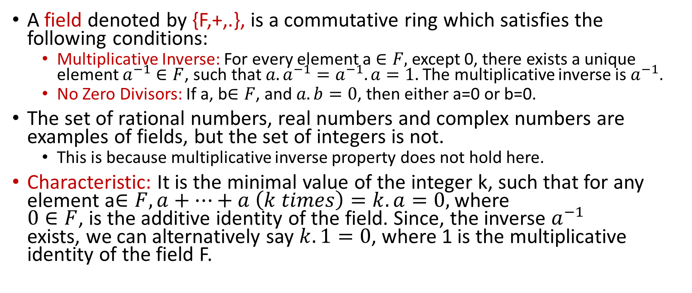
Groups, Rings, and Fields (contd.)
A field denoted by {F,+,.}, is a commutative ring which satisfies the following conditions:
Multiplicative Inverse: For every element a $∈F,$except 0, there exists a unique element $a^{−1}∈F$, such that $a.a^{−1}=a^{−1}.a=1.$The multiplicative inverse is $a^{−1}$.
No Zero Divisors: If a, b$∈F$, and $a.b=0$, then either a=0 or b=0.
The set of rational numbers, real numbers and complex numbers are examples of fields, but the set of integers is not.
This is because multiplicative inverse property does not hold here.
Characteristic: It is the minimal value of the integer k, such that for any element a$∈F, a+⋯+a \left(k times\right)=k.a=0,$ where $0∈F$, is the additive identity of the field. Since, the inverse $a^{−1}$ exists, we can alternatively say $k.1=0$, where 1 is the multiplicative identity of the field F.

Slide 6
GF(2): An Efficient Galois Field
Elements are {0,1}.
Most computing systems are built on binary number systems.
A single bit can be used to represent an element in GF(2)
Compare it with that required for GF(3).
Addition in GF(2) can be realized by only XORs.
Extension fields for GF(2) are denoted as GF(2^{m}) and also lead to efficient arithmetic operations.

Slide 7
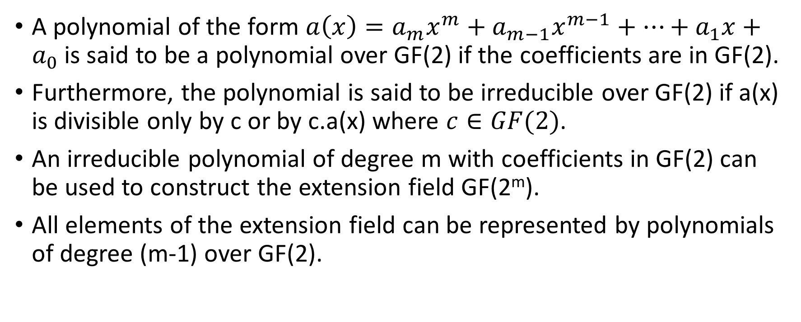
Binary Finite Fields
A polynomial of the form $a\left(x\right)=a_{m}x^{m}+a_{m−1}x^{m−1}+⋯+a_{1}x+a_{0}$is said to be a polynomial over GF(2) if the coefficients are in GF(2).
Furthermore, the polynomial is said to be irreducible over GF(2) if a(x) is divisible only by c or by c.a(x) where $c∈GF(2)$.
An irreducible polynomial of degree m with coefficients in GF(2) can be used to construct the extension field GF(2^{m}).
All elements of the extension field can be represented by polynomials of degree (m-1) over GF(2).

Slide 8
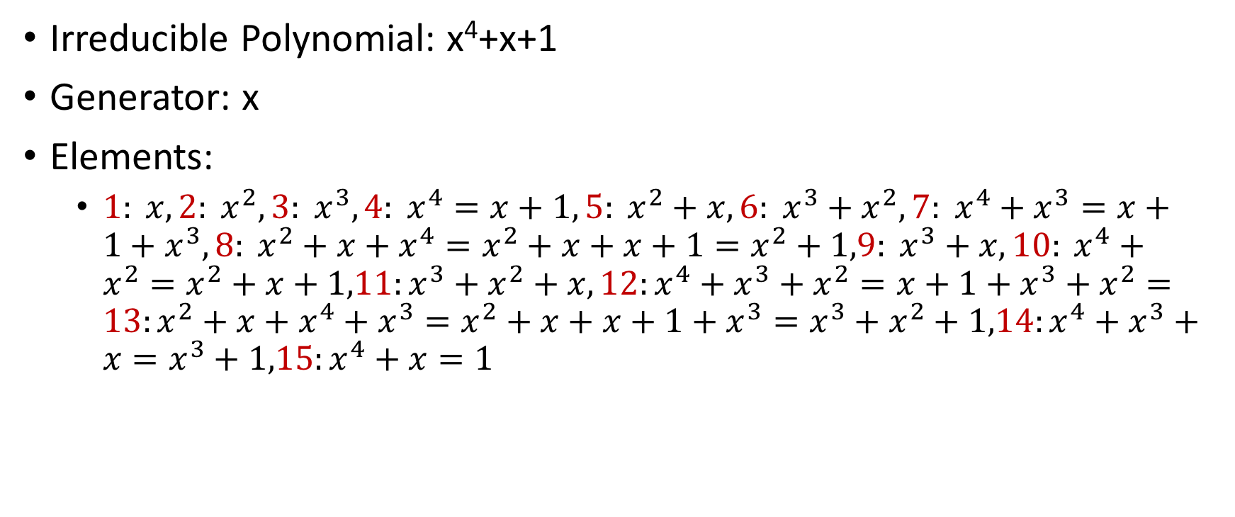
Example GF(2⁴)
Irreducible Polynomial: x⁴+x+1
Generator: x
Elements:
${1: x, 2: x}^{2},{3: x}^{3},{4: x}^{4}=x+1, 5: x^{2}+x,{6: x}^{3}+x^{2},{7: x}^{4}+x^{3}=x+1+x^{3},{8: x}^{2}+x+x^{4}=x^{2}+x+x+1=x^{2}+1,9: x^{3}+x,{10: x}^{4}+x^{2}=x^{2}+x+1,11:x^{3}+x^{2}+x, 12:x^{4}+x^{3}+x^{2}=x+1+x^{3}+x^{2}=13:x^{2}+x+x^{4}+x^{3}=x^{2}+x+x+1+x^{3}=x^{3}+x^{2}+1,14:x^{4}+x^{3}+x=x^{3}+1,15:x^{4}+x=1$

Slide 9
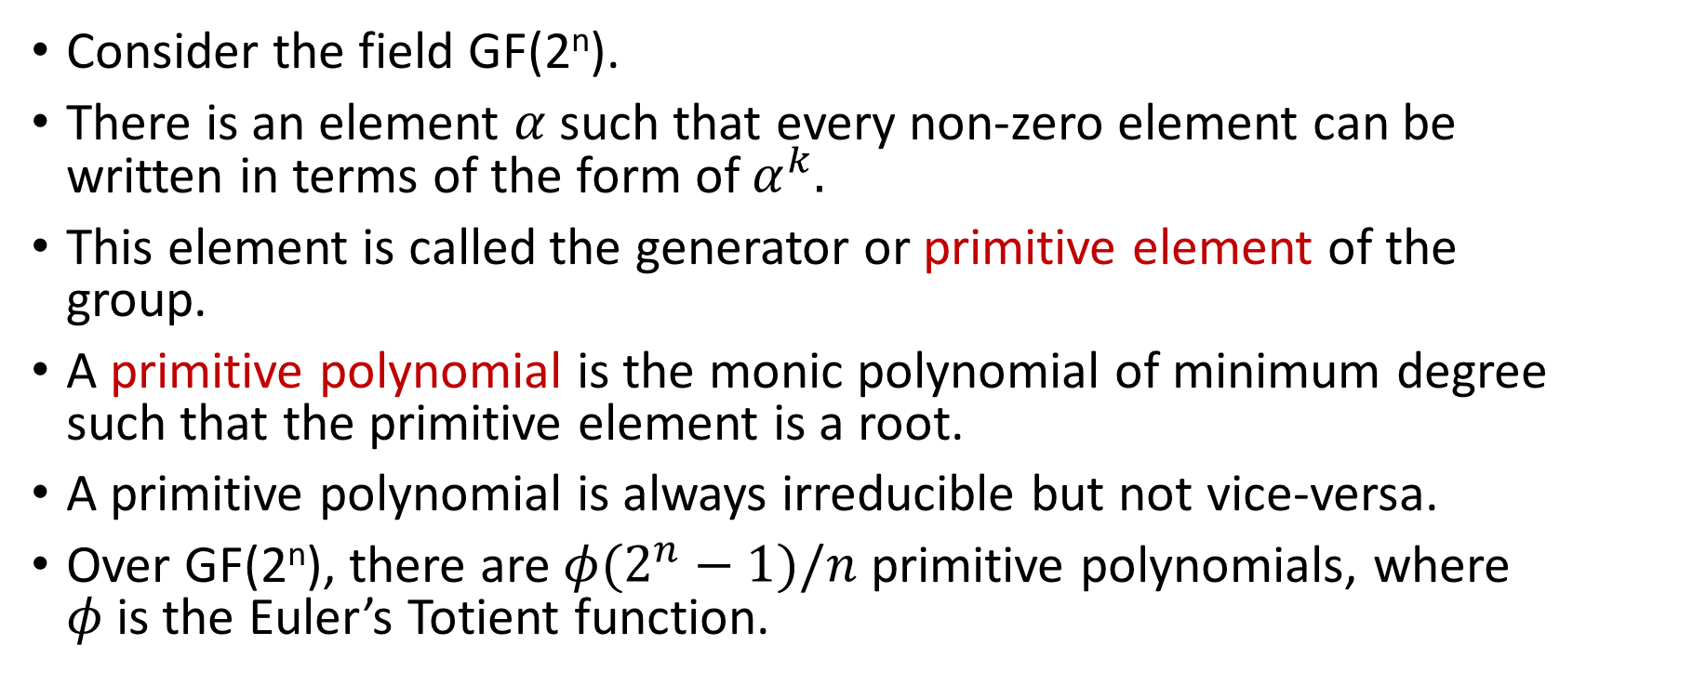
Primitive Element of a Field
Consider the field GF(2^{n}).
There is an element $α$such that every non-zero element can be written in terms of the form of $α^{k}.$
This element is called the generator or primitive element of the group.
A primitive polynomial is the monic polynomial of minimum degree such that the primitive element is a root.
A primitive polynomial is always irreducible but not vice-versa.
Over GF(2^{n}), there are $φ(2^{n}−1)/n$ primitive polynomials, where $φ$is the Euler’s Totient function.

Slide 10
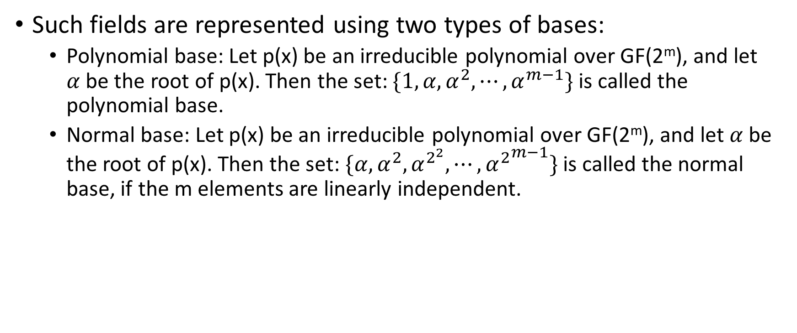
Bases of the Binary Field
Such fields are represented using two types of bases:
Polynomial base: Let p(x) be an irreducible polynomial over GF(2^{m}), and let $α$be the root of p(x). Then the set: $\{1,α,α^{2},⋯,α^{m−1}\}$ is called the polynomial base.
Normal base: Let p(x) be an irreducible polynomial over GF(2^{m}), and let $α$be the root of p(x). Then the set: $\{α,α^{2},α^{2^{2}},⋯,{α^{2}}^{m−1}\}$ is called the normal base, if the m elements are linearly independent.

Slide 11
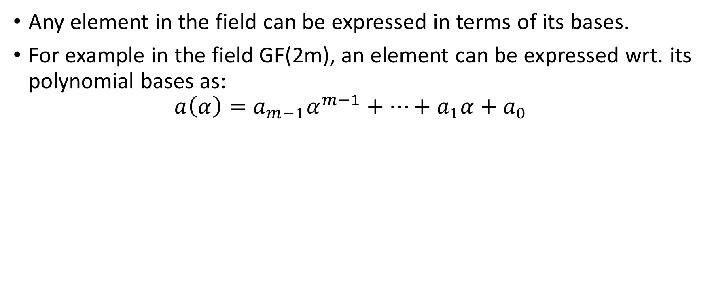
Polynomial Representation
Any element in the field can be expressed in terms of its bases.
For example in the field GF(2m), an element can be expressed wrt. its polynomial bases as:
$$a\left(α\right)=a_{m−1}α^{m−1}+⋯+a_{1}α+a_{0}$$

Slide 12
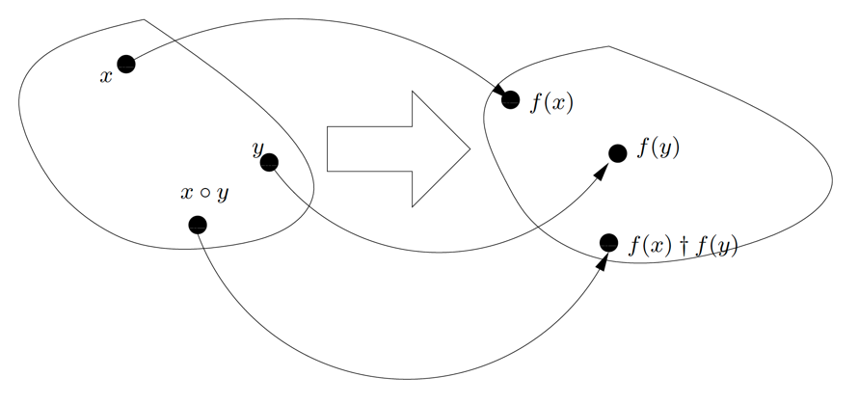
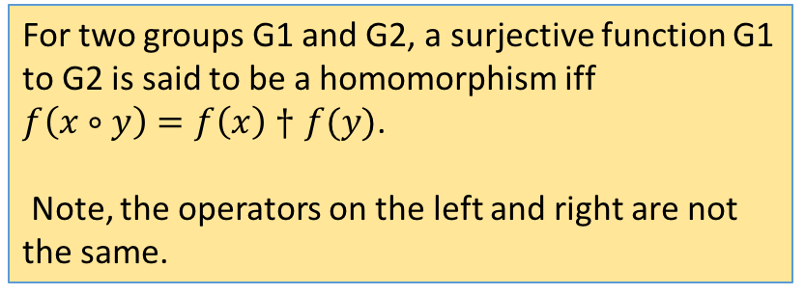
Isomorphism
For two groups G1 and G2, a surjective function G1 to G2 is said to be a homomorphism iff
$f\left(x∘y\right)=f\left(x\right)†f(y)$.
Note, the operators on the left and right are not the same.
An injective (one-to-one) homomorphism is called an isomorphism.
The idea of isomorphism can be extended to rings and fields. In these extensions the only difference is that the latter two are defined wrt. Two operators, say (+,.). Thus, we say f: R1→R2 is say a field isomorphism iff: f(a+b)=f(a)+f(b), and f(a.b)=f(a).f(b) for every a and b in R1.

Slide 13
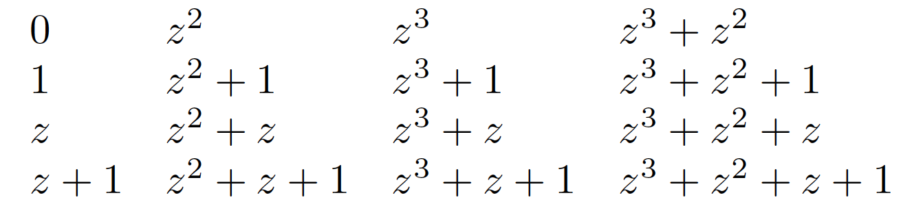
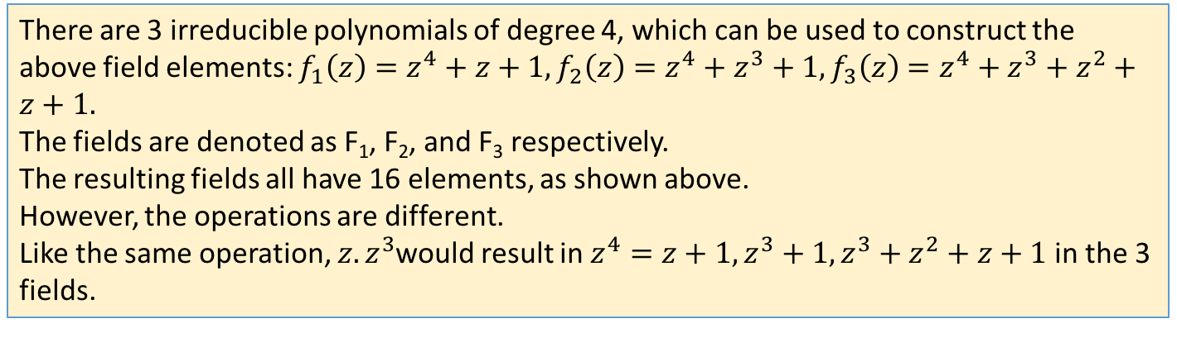
Example in GF(2⁴)
There are 3 irreducible polynomials of degree 4, which can be used to construct the above field elements: $f_{1}\left(z\right)=z^{4}+z+1, f_{2}\left(z\right)=z^{4}+z^{3}+1,f_{3}\left(z\right)=z^{4}+z^{3}+z^{2}+z+1.$
The fields are denoted as F₁, F₂, and F₃ respectively.
The resulting fields all have 16 elements, as shown above.
However, the operations are different.
Like the same operation, $z.z^{3}$would result in $z^{4}=z+1,z^{3}+1,z^{3}+z^{2}+z+1$in the 3 fields.

Slide 14
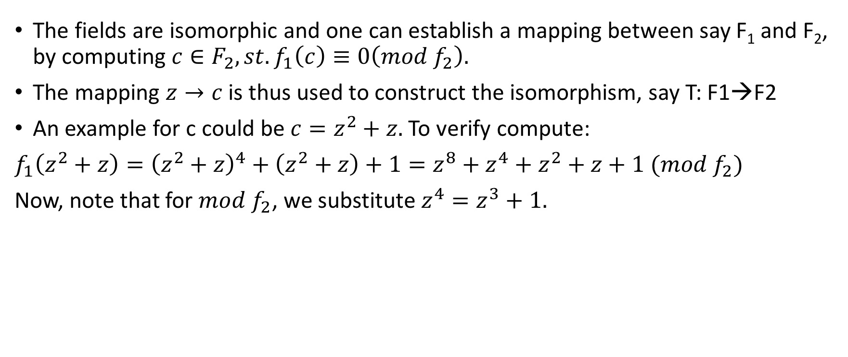
Defining Isomorphism
The fields are isomorphic and one can establish a mapping between say F₁ and F₂, by computing $c∈F_{2}, st. f_{1}\left(c\right)≡0\left(mod f_{2}\right).$
The mapping $z→c$ is thus used to construct the isomorphism, say T: F1→F2
An example for c could be $c=z^{2}+z.$To verify compute:
$f_{1}\left(z^{2}+z\right)={\left(z^{2}+z\right)}^{4}+\left(z^{2}+z\right)+1=z^{8}+z^{4}+z^{2}+z+1 (mod f_{2})$
Now, note that for $mod f_{2}$, we substitute $z^{4}=z^{3}+1.$

Slide 15
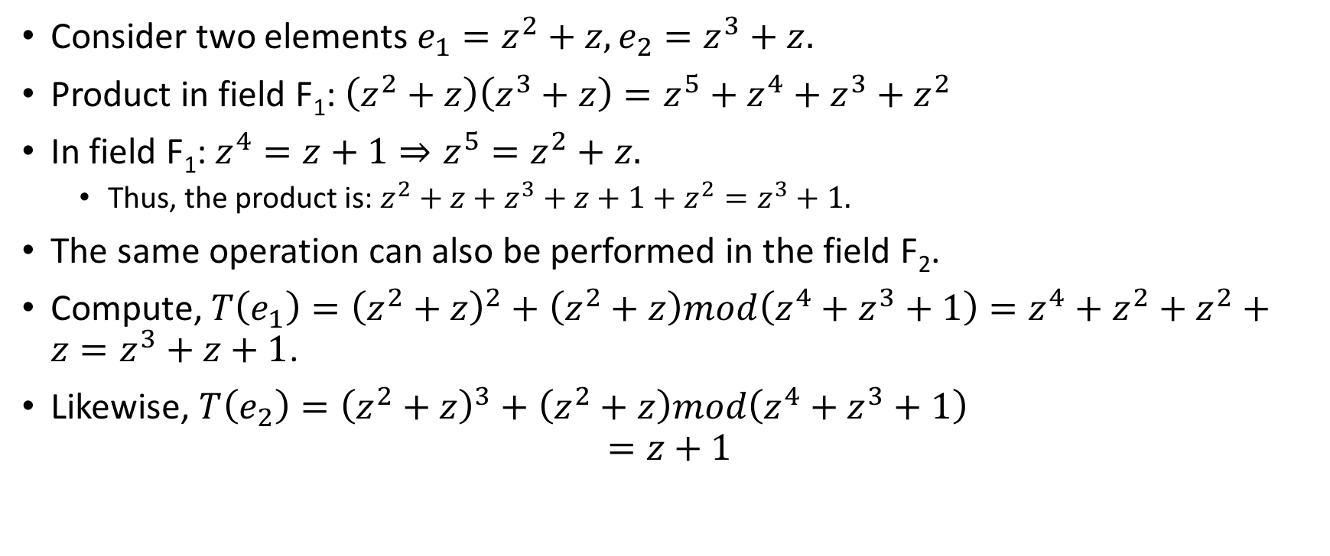
Check on Homomorphism
Consider two elements $e_{1}=z^{2}+z,e_{2}=z^{3}+z.$
Product in field F₁: $\left(z^{2}+z\right)\left(z^{3}+z\right)=z^{5}+z^{4}+z^{3}+z^{2}$
In field F₁: $z^{4}=z+1⇒z^{5}=z^{2}+z.$
Thus, the product is: $z^{2}+z+z^{3}+z+1+z^{2}=z^{3}+1.$
The same operation can also be performed in the field F₂.
Compute, $T\left(e_{1}\right)={\left(z^{2}+z\right)}^{2}+\left(z^{2}+z\right)mod\left(z^{4}+z^{3}+1\right)=z^{4}+z^{2}+z^{2}+z=z^{3}+z+1$.
Likewise, $T\left(e_{2}\right)={\left(z^{2}+z\right)}^{3}+\left(z^{2}+z\right)mod\left(z^{4}+z^{3}+1\right)$
$$=z+1$$

Slide 16
Check on Homomorphism

Slide 17
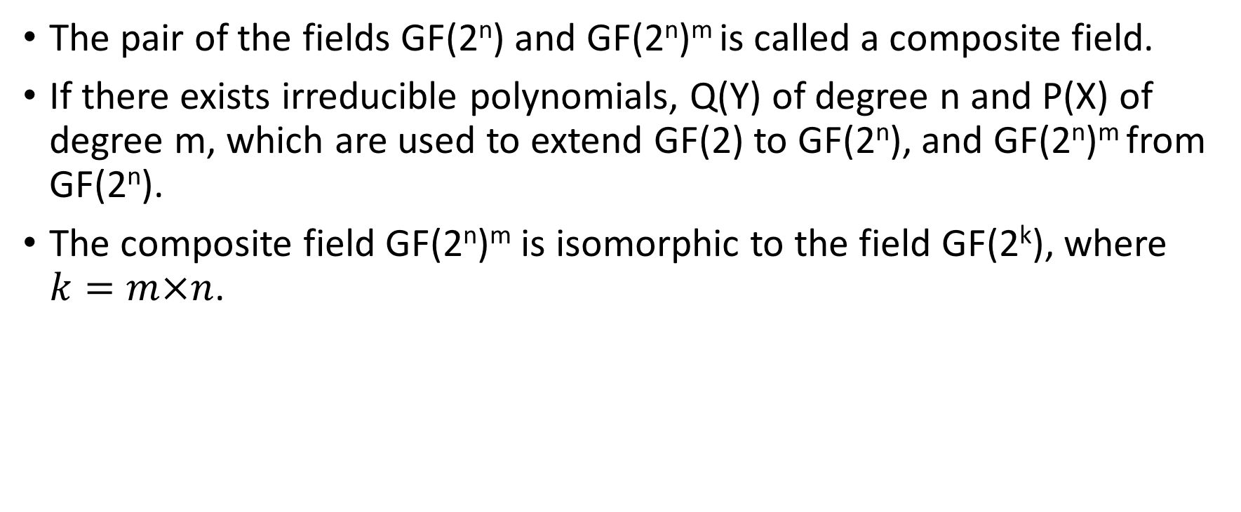
Composite Fields
The pair of the fields GF(2^{n}) and GF(2^{n})^{m} is called a composite field.
If there exists irreducible polynomials, Q(Y) of degree n and P(X) of degree m, which are used to extend GF(2) to GF(2^{n}), and GF(2^{n})^{m} from GF(2^{n}).
The composite field GF(2^{n})^{m} is isomorphic to the field GF(2^{k}), where $k=m×n$.

Slide 18
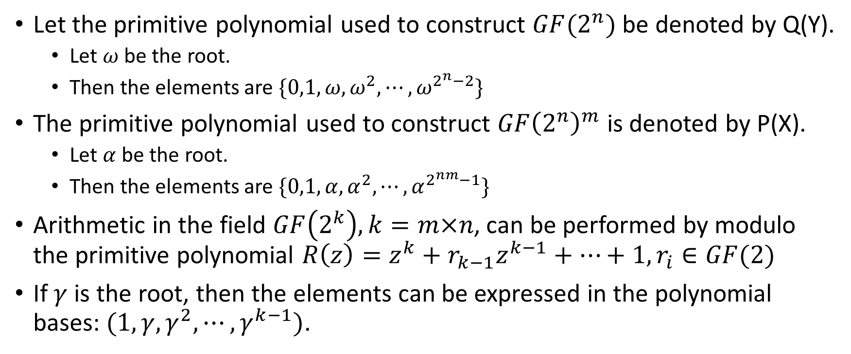
Constructing Isomorphisms between Composite Fields
Let the primitive polynomial used to construct $GF(2^{n})$ be denoted by Q(Y).
Let $ω$ be the root.
Then the elements are $\{0,1,ω,ω^{2},⋯,ω^{2^{n}−2}\}$
The primitive polynomial used to construct $GF{\left(2^{n}\right)}^{m}$ is denoted by P(X).
Let $α$ be the root.
Then the elements are $\{0,1,α,α^{2},⋯,α^{2^{nm}−1}\}$
Arithmetic in the field $GF\left(2^{k}\right),k=m×n$, can be performed by modulo the primitive polynomial $R\left(z\right)=z^{k}+r_{k−1}z^{k−1}+⋯+1, r_{i}∈GF(2)$
If $γ$ is the root, then the elements can be expressed in the polynomial bases: $(1,γ,γ^{2},⋯,γ^{k−1})$.

Slide 19
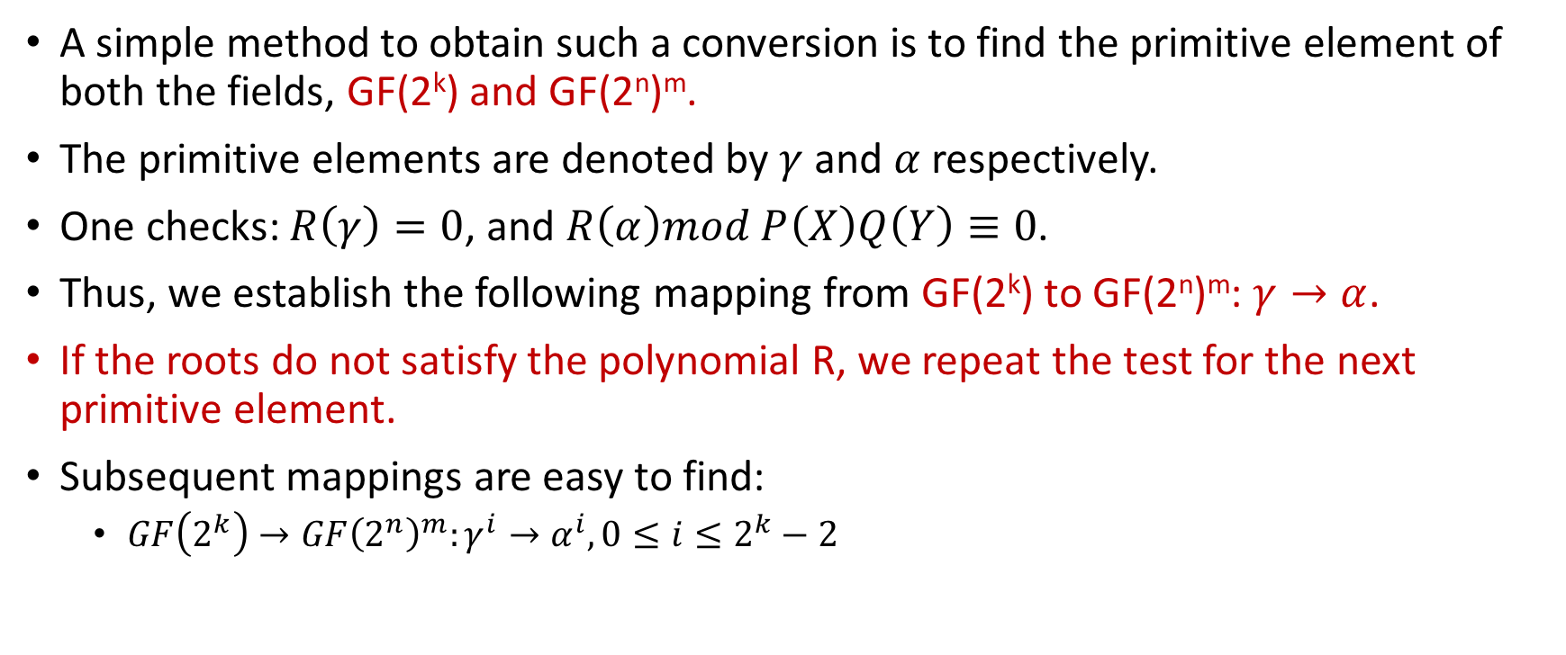
Mapping from GF(2^{k}) to GF(2^{n})^{m}, where k=nm
A simple method to obtain such a conversion is to find the primitive element of both the fields, GF(2^{k}) and GF(2^{n})^{m}.
The primitive elements are denoted by $γ$ and $α$ respectively.
One checks: $R\left(γ\right)=0$, and $R\left(α\right)mod P\left(X\right)Q\left(Y\right)≡0$.
Thus, we establish the following mapping from GF(2^{k}) to GF(2^{n})^{m}: $γ→α$.
If the roots do not satisfy the polynomial R, we repeat the test for the next primitive element.
Subsequent mappings are easy to find:
$GF\left(2^{k}\right)→GF{\left(2^{n}\right)}^{m}:γ^{i}→α^{i}, 0≤i≤2^{k}−2$

Slide 20
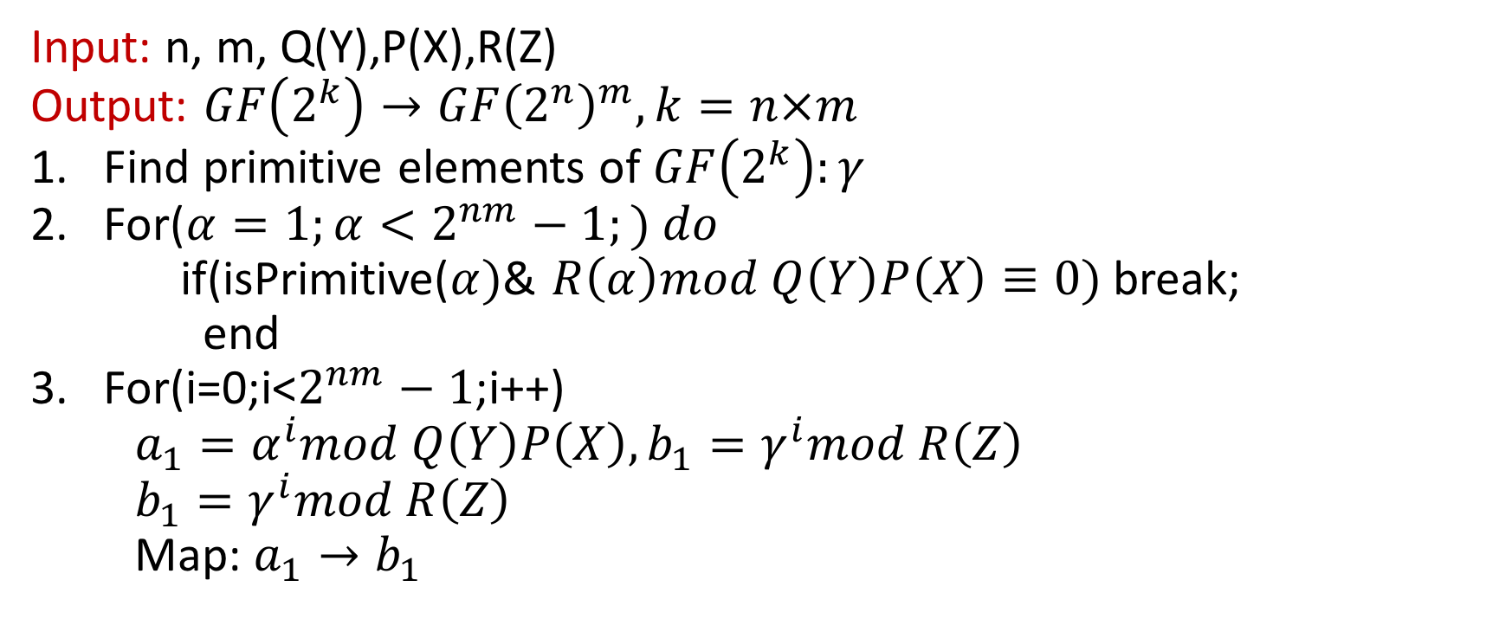
Algorithm
Input: n, m, Q(Y),P(X),R(Z)
Output: $GF\left(2^{k}\right)→GF{\left(2^{n}\right)}^{m}, k=n×m$
Find primitive elements of $GF\left(2^{k}\right):γ$
For($α=1;α<2^{nm}−1;) do$
if(isPrimitive($α)$& $R\left(α\right)mod Q\left(Y\right)P\left(X\right)≡0)$break;
end
For(i=0;i<$2^{nm}−1$;i++)
$a_{1}=α^{i}mod Q\left(Y\right)P\left(X\right), b_{1}=γ^{i}mod R\left(Z\right)$
$b_{1}=γ^{i}mod R\left(Z\right)$
Map: $a_{1}→b_{1}$

Slide 21
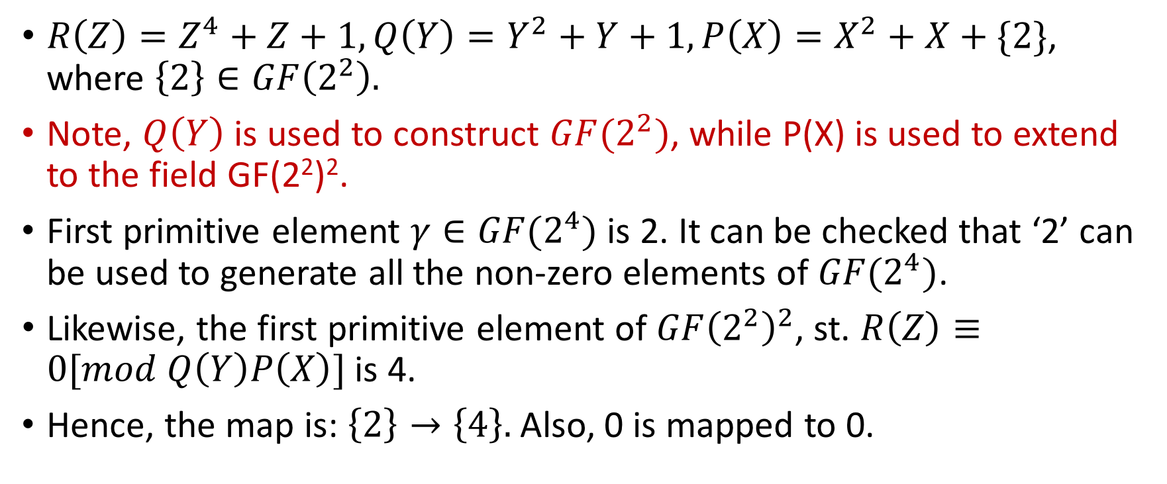

Example: $GF\left(2^{4}\right)→GF{\left(2^{2}\right)}^{2}$
$R\left(Z\right)=Z^{4}+Z+1, Q\left(Y\right)=Y^{2}+Y+1,P\left(X\right)=X^{2}+X+\{2\}$, where $\left\{2\right\}∈GF\left(2^{2}\right).$
Note, $Q\left(Y\right)$ is used to construct $GF(2^{2})$, while P(X) is used to extend to the field GF(2²)².
First primitive element $γ∈GF(2^{4})$ is 2. It can be checked that ‘2’ can be used to generate all the non-zero elements of $GF(2^{4})$.
Likewise, the first primitive element of $GF{\left(2^{2}\right)}^{2}$, st. $R\left(Z\right)≡0[mod Q\left(Y\right)P\left(X\right)]$ is 4.
Hence, the map is: $\left\{2\right\}→\left\{4\right\}.$Also, 0 is mapped to 0.

Slide 22
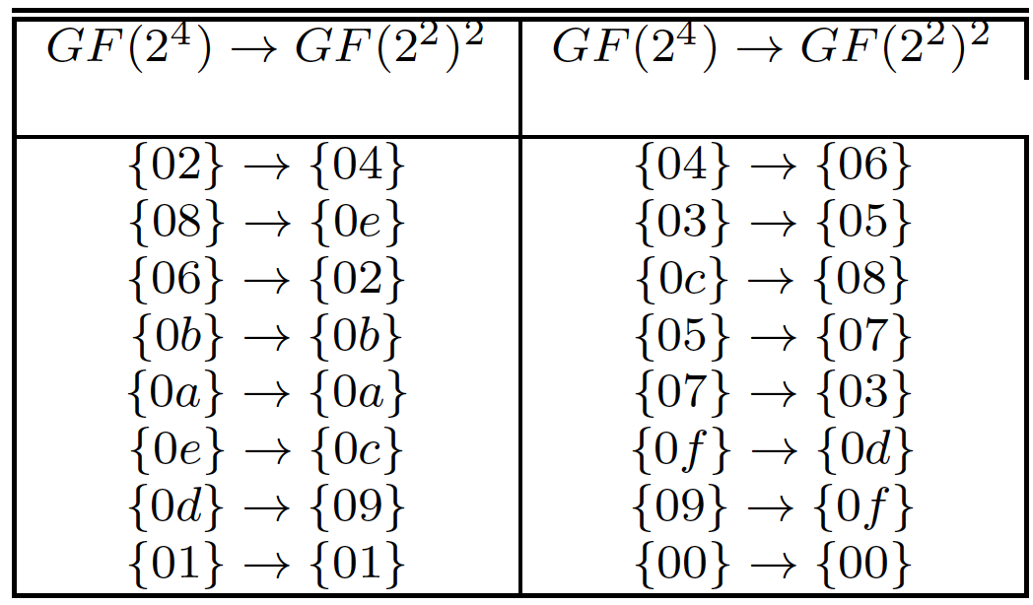
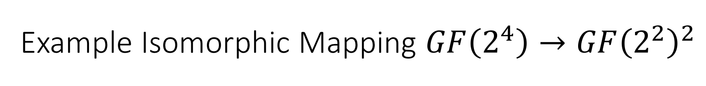
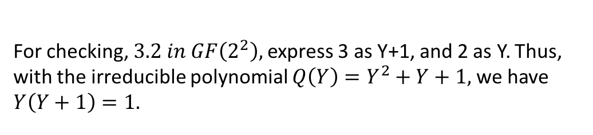
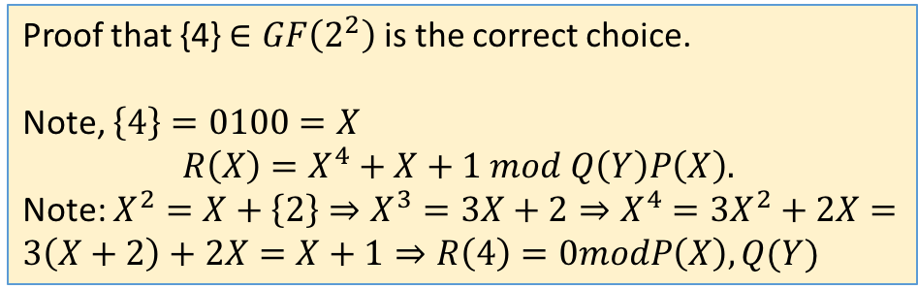
Example Isomorphic Mapping $GF\left(2^{4}\right)→GF{\left(2^{2}\right)}^{2}$
Proof that {4} $∈GF\left(2^{2}\right)$ is the correct choice.
Note, $\left\{4\right\}=0100=X$
$$R\left(X\right)=X^{4}+X+1 mod Q\left(Y\right)P\left(X\right).$$
Note: $X^{2}=X+\left\{2\right\}⇒X^{3}=3X+2⇒X^{4}=3X^{2}+2X=3\left(X+2\right)+2X=X+1⇒R\left(4\right)=0modP\left(X\right),Q(Y)$
For checking, $3.2 in GF\left(2^{2}\right),$express 3 as Y+1, and 2 as Y. Thus, with the irreducible polynomial $Q\left(Y\right)=Y^{2}+Y+1,$we have $Y\left(Y+1\right)=1.$

Slide 23
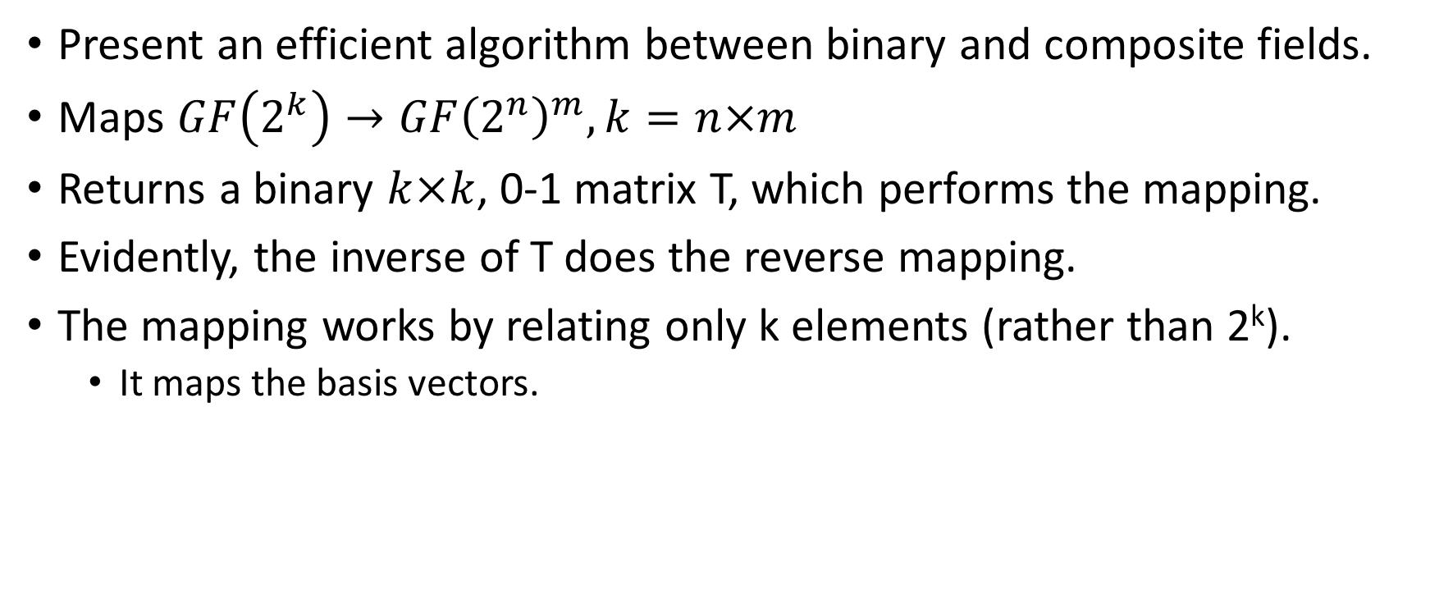
An Efficient Conversion Algorithm
Present an efficient algorithm between binary and composite fields.
Maps $GF\left(2^{k}\right)→GF{\left(2^{n}\right)}^{m}, k=n×m$
Returns a binary $k×k$, 0-1 matrix T, which performs the mapping.
Evidently, the inverse of T does the reverse mapping.
The mapping works by relating only k elements (rather than 2^{k}).
It maps the basis vectors.

Slide 24
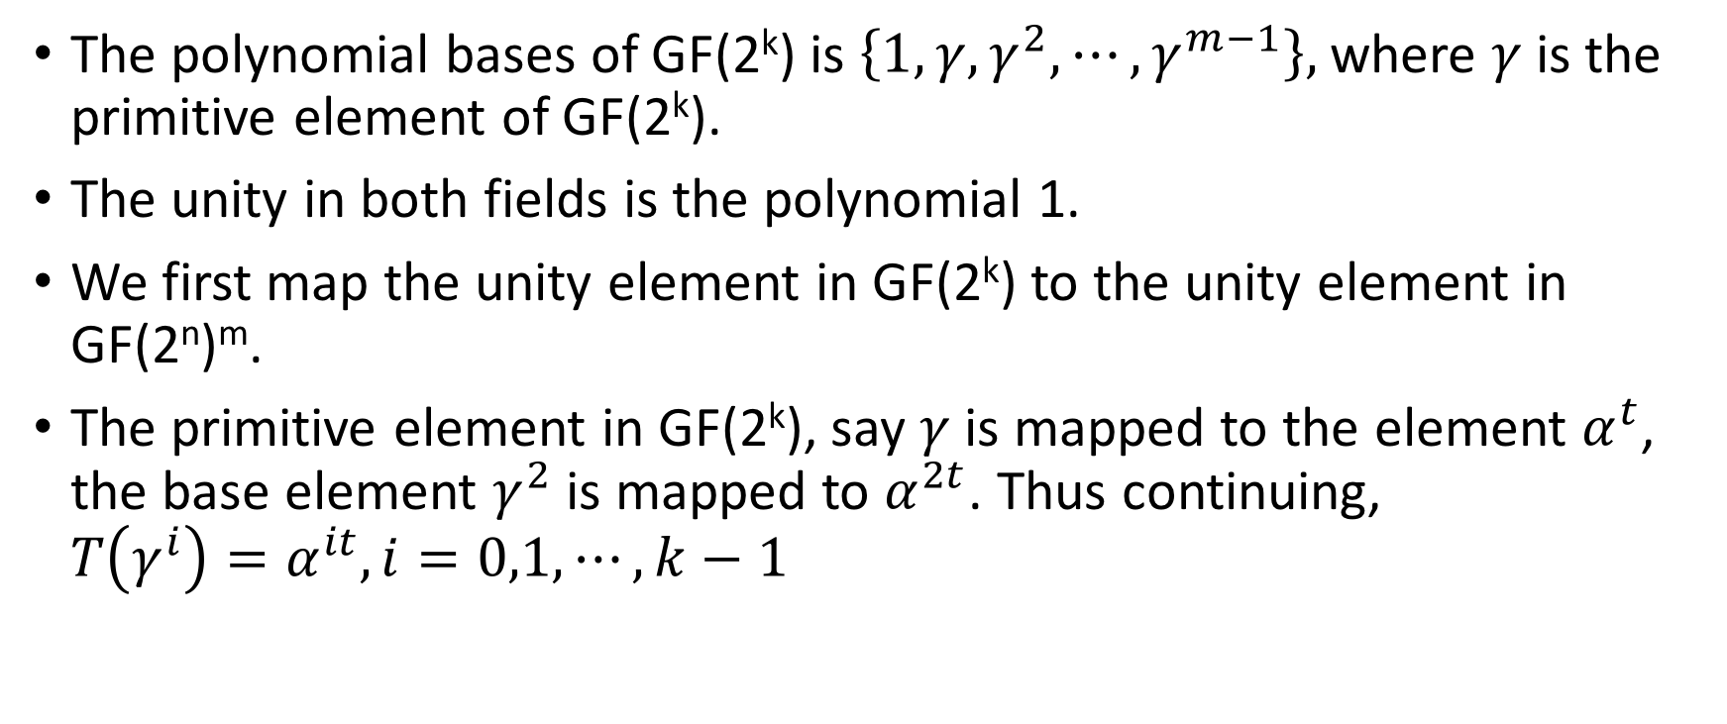
Mapping the k elements
The polynomial bases of GF(2^{k}) is $\left\{1,γ,γ^{2},⋯,γ^{m−1}\right\},$where $γ$ is the primitive element of GF(2^{k}).
The unity in both fields is the polynomial 1.
We first map the unity element in GF(2^{k}) to the unity element in GF(2^{n})^{m}.
The primitive element in GF(2^{k}), say $γ$ is mapped to the element $α^{t}$, the base element $γ^{2}$ is mapped to $α^{2t}$. Thus continuing, $T\left(γ^{i}\right)=α^{it}, i=0,1,⋯,k−1$

Slide 25
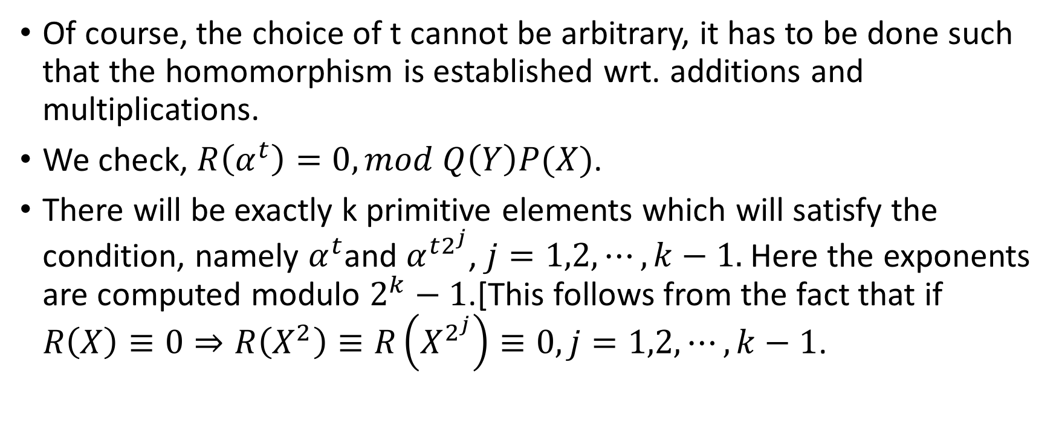
Check for t
Of course, the choice of t cannot be arbitrary, it has to be done such that the homomorphism is established wrt. additions and multiplications.
We check, $R\left(α^{t}\right)=0,mod Q\left(Y\right)P(X)$.
There will be exactly k primitive elements which will satisfy the condition, namely $α^{t}$and $α^{t2^{j}}$, $j=1,2,⋯,k−1.$Here the exponents are computed modulo $2^{k}−1$.[This follows from the fact that if $R\left(X\right)≡0⇒R\left(X^{2}\right)≡R\left(X^{2^{j}}\right)≡0, j=1,2,⋯,k−1$.

Slide 26
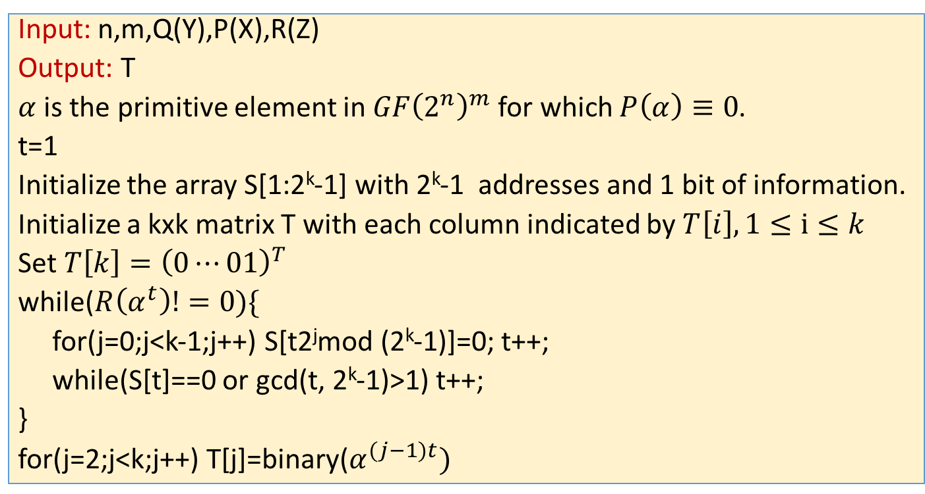
Algorithm
Input: n,m,Q(Y),P(X),R(Z)
Output: T
$α$ is the primitive element in $GF{\left(2^{n}\right)}^{m}$ for which $P\left(α\right)≡0$.
t=1
Initialize the array S[1:2^{k}-1] with 2^{k}-1 addresses and 1 bit of information.
Initialize a kxk matrix T with each column indicated by $T\left[i\right], 1≤i≤k$
Set $T\left[k\right]={\left(0⋯01\right)}^{T}$
while($R\left(α^{t}\right)!=0)\{$
for(j=0;j<k-1;j++) S[t2^{j}mod (2^{k}-1)]=0; t++;
while(S[t]==0 or gcd(t, 2^{k}-1)>1) t++;
}
for(j=2;j<k;j++) T[j]=binary($α^{(j−1)t})$

Slide 27


Slide 28
Conclusion:
Field Isomorphism was defined.
We developed understanding on these equivalent fields which are called as composite fields.
We also discussed conversion algorithms between the fields.

Slide 29


